Slide 1
ASP.NET Web API
Basics
Rahul Srivastava

Slide 2
ASP.NET WebAPI
ASP.NET Web API is a framework that makes it easy to build HTTP and REST services using the .NET framework.

Slide 3
WebAPI Controllers
An ApiController does the work
Access to the HTTP Request and Response
Use ModelBinding to ease working with resources
But also provides HttpRequestMessage for low level access

Slide 4
WebAPI Controllers
Lots of control about sending resources to the client
HttpResponseMessage
Content negotiation
Set any HTTP header you like
Caching
Optimistic concurrency

Slide 5
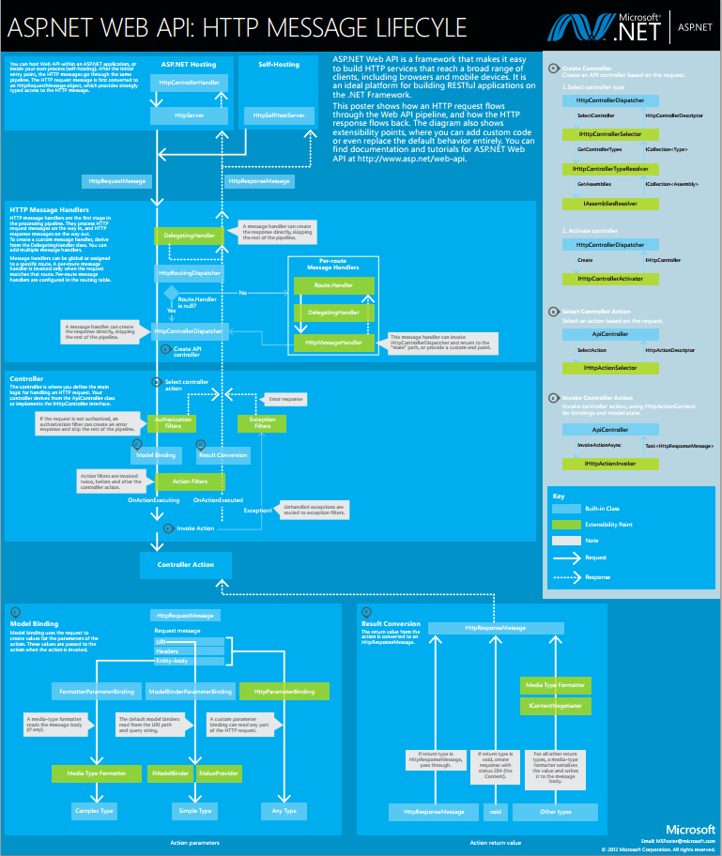

Slide 6
Web API Processing Architecture
controller
message
HttpRequestMessage
HttpResponseMessage
hosting

Slide 7
HTTP Request
GET /index.html HTTP/1.1 Accept: text/html
Accept-Encoding: gzip, deflate
Accept-Language: en-US
User-Agent: Mozilla/5.0
Connection: Keep-Alive

Slide 8
HttpRequestMessage
In System.Net.Http namespace
Properties:
Content – HttpContent
Headers – HttpRequestHeaders
Method – HttpMethod
Properties – IDictionary<string, object>
RequestUri – Uri

Slide 9
Request Extensions
CreateErrorResponse – many overloads
CreateResponse – many overloads
GetClientCertificate
GetProperty<T>
GetQueryNameValuePairs
GetUrlHelper
These are in System.Net.Http.dll.

Slide 10
HTTP Response
HTTP/1.1 200 OK
Cache-Control: private, max-age=0
Content-Type: text/html; charset=utf-8
Vary: Accept-Encoding
Date: Thu, 31 Dec 2015 23:59:59 GMT
Content-Length: 41309
Connection: keep-alive
Set-Cookie: XYZ=123; domain=.me.com; path=/ ...

Slide 11
HttpResponseMessage
In System.Net.Http namespace
Properties:
Content – HttpContent
Headers – HttpResponseHeaders
IsSuccessStatusCode – bool
ReasonString – string
RequestMessage – HttpRequestMessage
StatusCode – HttpStatusCode

Slide 12
Key Attributes
AcceptVerbs
Authorize
AllowAnonymous
NonAction
FromBody
FromUri
Queryable
HttpGet
HttpPost
HttpPut
HttpPatch
HttpDelete
HttpHead
HttpOptions

Slide 13
WebAPI Routes
public static void Register(HttpConfiguration config)
{
config.Routes.MapHttpRoute(
name: "DefaultApi",
routeTemplate: "api/{controller}/{id}",
defaults: new { id = RouteParameter.Optional }
);
}

Slide 14
WebAPI Controllers
public class DemoController : ApiController
{
// GET api/demo
public IEnumerable<string> Get()
{
return new string[] { "value1", "value2" };
}
}

Slide 15
WebAPI Routes
Couple an incoming URL to an ApiController
Just like with ASP.NET MVC
Create as many as you like
The ordering is important!

Slide 16
Content negotiation
What resource we send != how we send it
JSON of XML: a book resource is still a book resource

Slide 17
MediaTypeFormatter
The media type specifies the serialization format
JSON, XML, Word, PDF, VCard etc
The MediaTypeFormatter (de)serializes
HTTP <> CLR type
Content negotiation determines the serialized format
The client uses the HTTP Accept header

Slide 18
HTTP Methods
HTTP supports many HTTP Methods
With HTML we only use two
The HTTP Method determines our goal
Just like the database CRUD actions

Slide 19
HTTP Methods
Aktie | HTTP Method
Create | POST
Read | GET
Update (completly replace) | PUT
Update (partial replace) | PATCH
Delete | DELETE

Slide 20
WebAPI HTTP Methods
public class DemoController : ApiController {
// GET api/demo
public IEnumerable<string> Get()
// GET api/demo/5
public string Get(int id)
// POST api/demo
public void Post([FromBody]string value)
// PUT api/demo/5
public void Put(int id, [FromBody]string value)
// DELETE api/demo/5
public void Delete(int id)
}

Slide 21
Hypermedia - Roy T. Fielding
Hypermedia is defined by the presence of application control information embedded within, or as a layer above, the presentation of information. Distributed hypermedia allows the presentation and control information to be stored at remote locations.
Roy T. Fielding

Slide 22
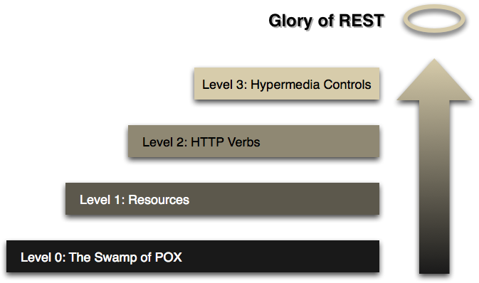
Richardson Maturity Model

Slide 23
The OData Protocol
Open Data Protocol (OData)
A hypermedia web protocol for retrieving and updating data.
Based on the W3C AtomPub standard
Can include metadata
WCF Data Services is an implementation

Slide 24
OData metadata
An OData service can return metadata
http://www.nerddinner.com/Services/OData.svc/$metadata
Enables generic clients like PowerPivot for Excel

Slide 25
ASP.NET WebAPI and OData
Standard ApiController’s support basic querying
$filter
$orderby
$skip
$take
$expand and $select support coming soon
Needs to be explicitly enabled
public static void Register(HttpConfiguration config)
{
// Other config
config.EnableQuerySupport();
}

Slide 26

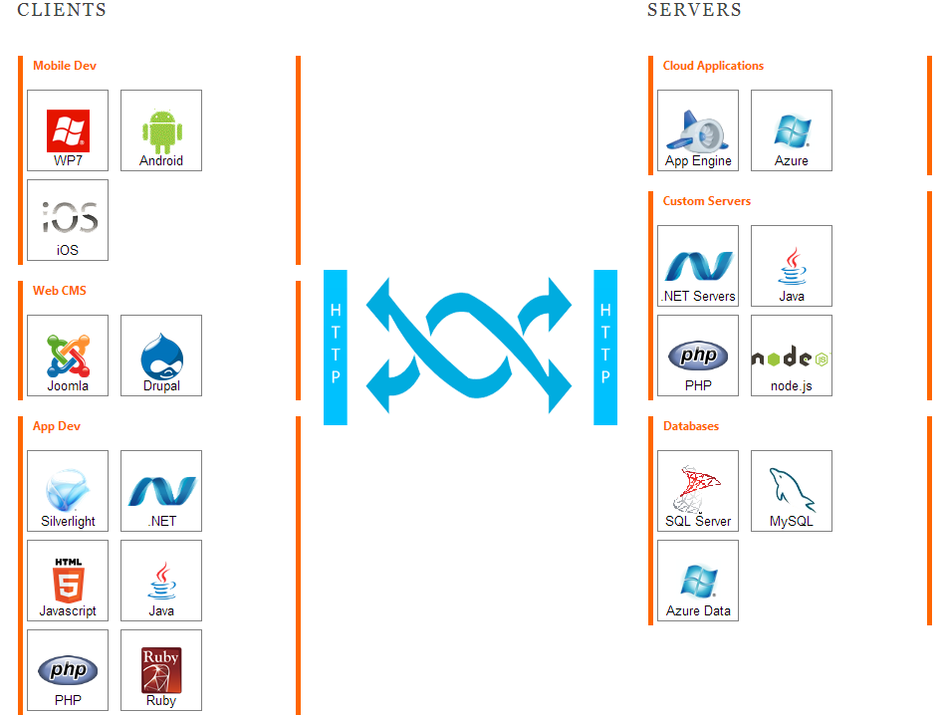
OData
OData is a standardized protocol for creating and consuming data APIs.

Slide 27
Query string options
$Expand
/Customers(ALFKI)?$expand=Orders.Employees
$Orderby
/Customers?$orderby=City desc, CompanyName
$Skip
/Customers?$skip=10
$Top
/Orders?$orderby=TotalDue&$top=5
$Filter
/Customers?$filter=City eq ‘London’

Slide 28
Thanks
Rahul Srivastava

